Slide 1

global Health data analysis using azure

Slide 2
agenda
Project Overview
Project Requirements
Data Overview
Project Workflow
Architecture Diagram
Outcomes
Conclusion

Slide 3

Project overview
The Serverless Data Processing Pipeline project focuses on automating the processing and analysis of global health data, including disease prevalence, mortality rates, and healthcare access.
Using Azure Data Factory for workflow orchestration and Azure Databricks for serverless data processing, the solution extracts valuable insights to support global health research and decision-making.
The pipeline automates data ingestion, transformation, and analysis.

Slide 4
Project requirements
Azure Data Factory (ADF) ADF automates data movement and transformation, creating pipelines to ingest data into Azure Data Lake or Databricks. It orchestrates workflows to connect various data sources and manage tasks across services.
Azure Databricks Azure Databricks is a cloud-based analytics platform that processes large datasets and runs machine learning models. It transforms and analyzes data stored in Azure Data Lake to generate insights efficiently.
Azure Data Lake Storage Azure Data Lake Storage is a scalable repository for both raw and processed data. It stores health data ingested via ADF, allowing Databricks to access and process the data for further analysis.

Slide 5
Data overview
The Global Health Data dataset, sourced from Kaggle, contains over 1 million+ records, offering a comprehensive view of global health trends.
It includes key health metrics such as Prevalence Rate, Incidence Rate, Mortality Rate, and Recovery Rate for various diseases.
Additionally, demographic details like Age Group, Gender, and Population Affected are provided, along with healthcare infrastructure information, including Healthcare Access, Doctors per 1000, and Hospital Beds per 1000.
The dataset also incorporates economic indicators like Per Capita Income and Education Index, offering valuable insights into the socio-economic factors affecting health outcomes.

Slide 6
Project Workflow
The workflow of the Global Health Data Analysis using Azure is as follows:
1. Data Processing with Databricks:
Azure Databricks is used to perform data transformations and analytics in a serverless environment, reducing infrastructure management overhead.
Databricks Notebook 1 is responsible for the initial data cleaning and ingestion, using PySpark to load and clean the data from the Data Lake, and saving it as a Delta table for consistency.
Databricks Notebook 2 performs visualization.

Slide 7
Project Workflow
2. Pipeline Orchestration with Azure Data Factory:
A single pipeline in Azure Data Factory orchestrates the execution of the two Databricks notebooks sequentially.
The first notebook (Notebook 1) runs to clean the data, and once completed, the second notebook (Notebook 2) start running. These notebooks are connected within the same pipeline to ensure sequential execution.
The trigger is created to schedule or manually start the pipeline. A manual trigger allows ad-hoc execution, while a scheduled trigger enables periodic executions (e.g., daily, weekly).
3. Monitoring and Optimization:
Azure Data Factory’s monitoring tools track pipeline execution, displaying detailed logs, error reports, and runtime information.

Slide 8
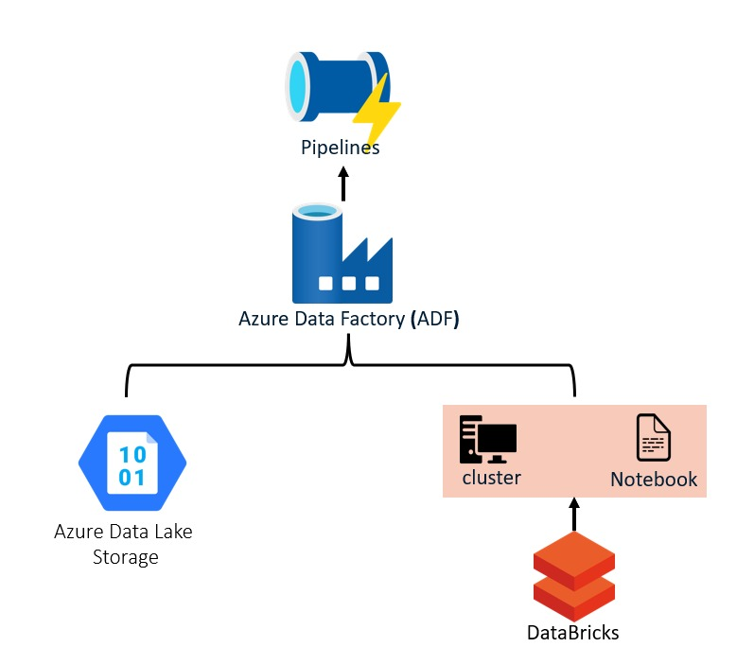
Architecture diagram

Slide 9
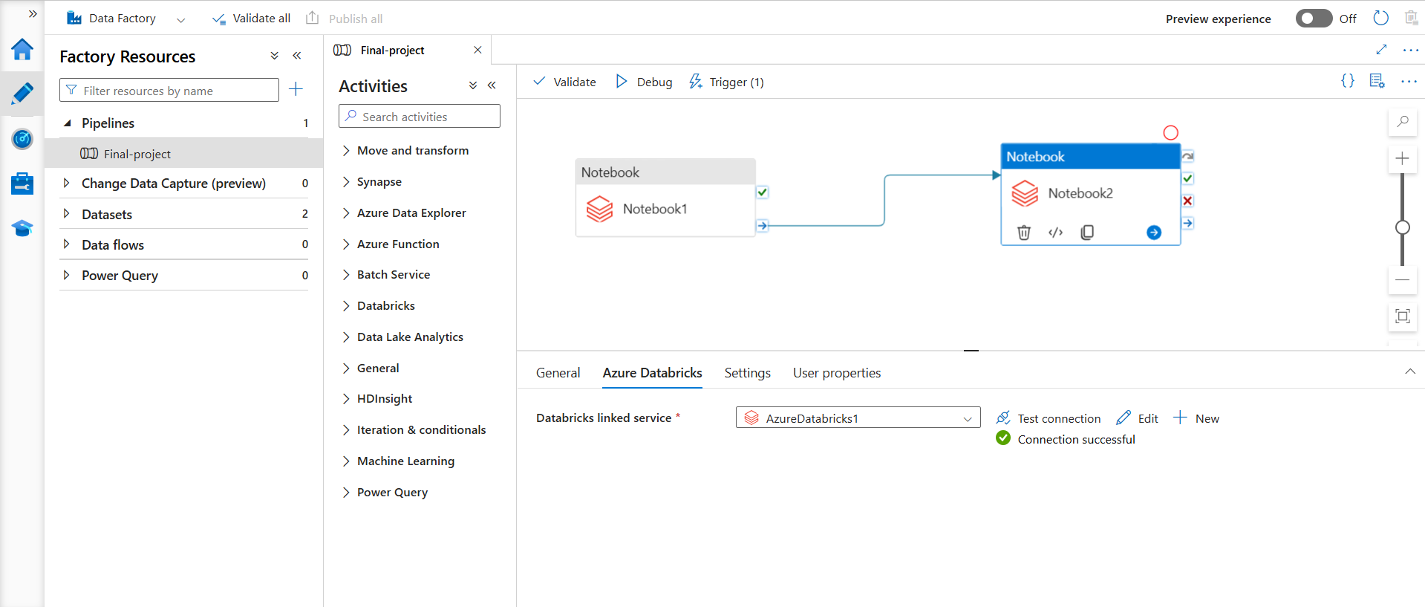
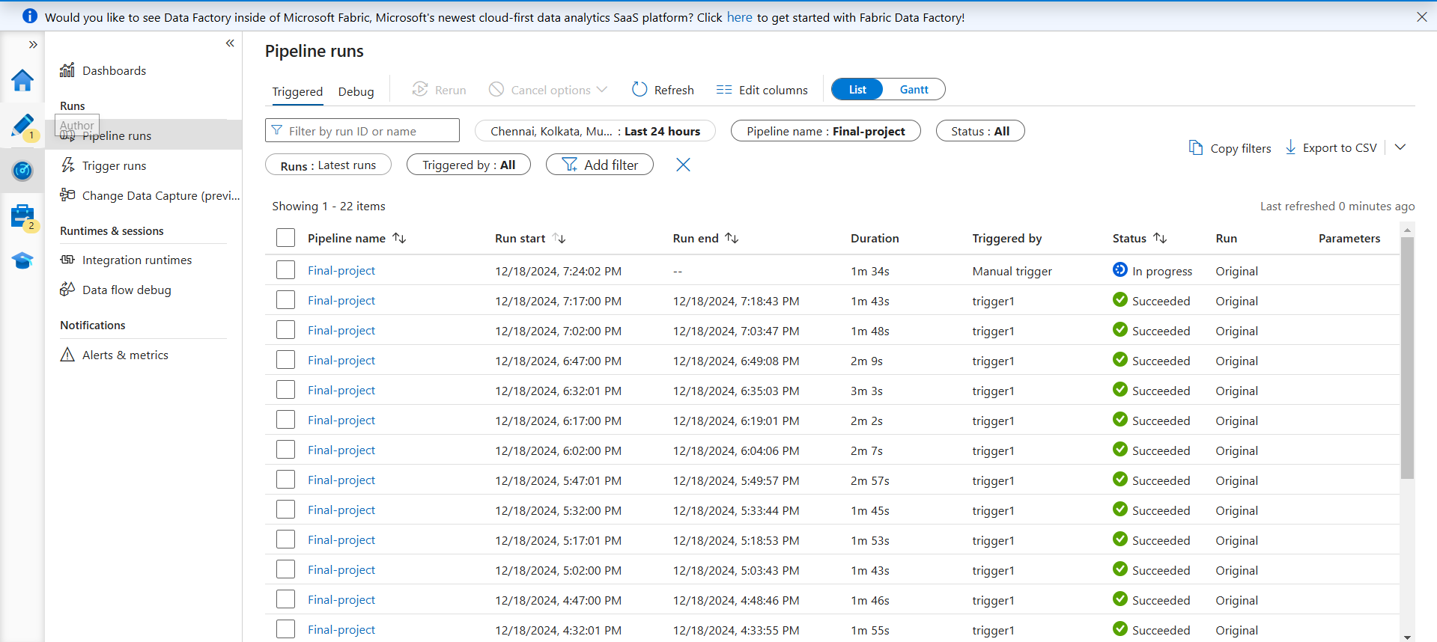
outcomes

Slide 10
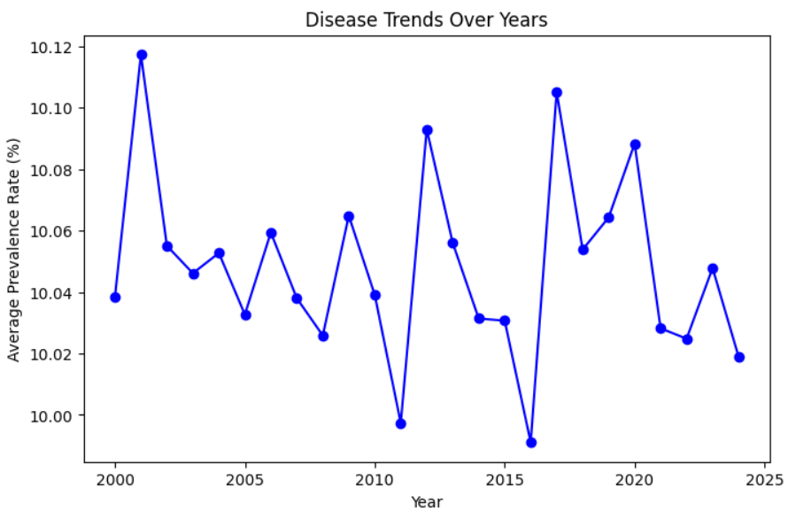
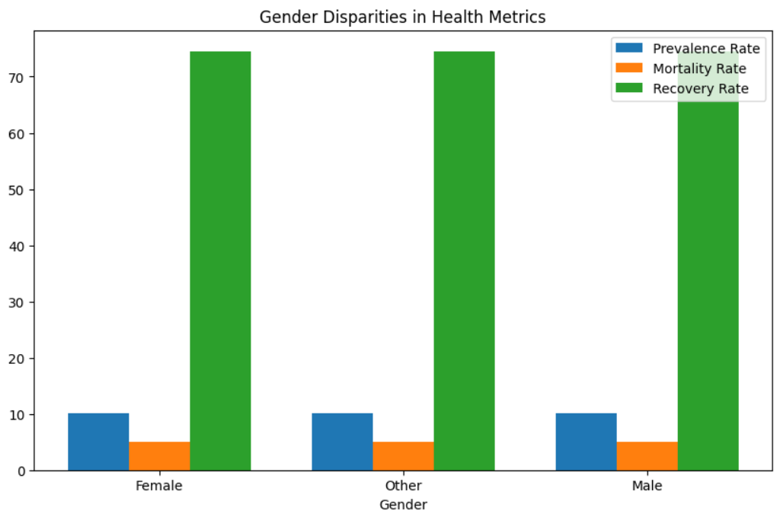
outcomes

Slide 11
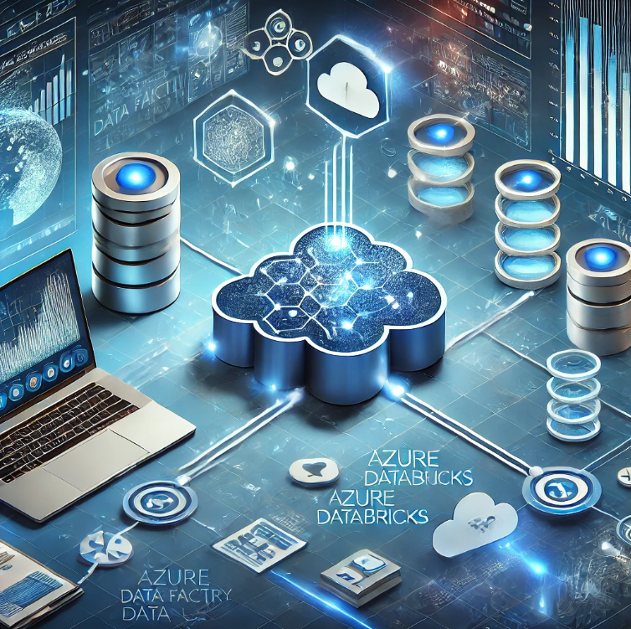
Conclusion
This project successfully implements a serverless data processing pipeline using Azure Data Factory and Azure Databricks to manage and analyze Global Health Data.
By automating data ingestion, transformation, and orchestration, we have created a scalable, flexible solution for processing large volumes of health data.
The results of this project can aid in public health research, enabling data-driven decision-making for better healthcare policies and outcomes globally.

Slide 12
Thank you
Mahesh Ratneshwar Godale
Abhilash Gowda S

